Slide 1
Pandemic Watching
University of Denver Data Analytics Bootcamp
Project #1
Saturday, February 6, 2021
Presented by: Alyson Amtman, Susan Farago, Sara Kayhan,
Swati Oberoi Dham, Catherine Poirier, and Aishwarya Rao
Notes:
Alyson

Slide 2
Pandemic Watching
Unfortunately, due to COVID-19, we watched a lot of movies in 2020.
So we wondered...
...was it just us?
...what did other people watch?
... were our 2020 movie habits different from our 2019 habits?
...was there any relationship between COVID-19 numbers and movie watching?
Notes:
Alyson

Slide 3
Motivation & Summary
Our project analyzes the trends in Over the Top (OTT) movie platform viewing habits.
Today we will examine data between 2019 and 2020 and look for shifts in genre and identify other significant changes in viewing patterns.
Notes:
Alyson

Slide 4
Our Questions
What were the significant changes or noticeable trends in movies between 2019 to 2020?
What were the most/least popular genres?
What was the total revenue made by the industry in 2019 vs 2020?
Are there any correlations between ratings and watch volumes?
What future predictions can we make based on 2020 data patterns?
Can we correlate viewing habits with COVID-19 cases?
Was there a trend in COVID-19 cases and Netflix subscriptions?
Data Sources: IMDB/TMDB/Flixit/Statista Netflix Worldometer Covid
Notes:
Alyson- here’s what we did...we took a look at movie trends during lockdown in 2020 and compared it to data from the year prior in 2019. Then we wanted to know what was the most popular and least popular genre of movie watched during the pandemic and what was the total revenue that was made by the industry in 2020 compared to 2019….
As we began digging deeper we wanted to know was there any correlations between ratings and watch volumes….
And we tried to make future predictions based on 2020 data patterns…..how can we correlate viewing habits with COVID-19 cases…..YOU GUYS ARE ABOUT TO EMBARK ON A JOURNEY TO FIND OUT….. WAS THERE A TREND IN COVID-19 CASES AND NETFLIX SUBSCRIPTIONS??? THIS IS YOUR LUCKY DAY CAUSE YOUR ABOUT TO FIND OUT!!!!

Slide 5
Hypothesis
Do we accept or reject the null hypothesis?
H_{0 :} The number of ratings of a given genre has no relationship to the number of movie votes in that genre.
H_{a}: The number of ratings of a given genre has a strong positive relationship to the number of movie votes in that genre.
Notes:
Alyson- with any good data science project we came to our presumption that states that our null hypothesis rejects our findings and our alternative hypothesis accepts our conclusion.

Slide 6

Data Analysis Process
Step 1: We Explored and Visualized Data
Step 2: Data Mining
Step 3: Build Models
Step 4: Generate Results and Optimize Data
Step 5: Validate Results
Step 6: Process and Clean Data
Notes:
Catherine

Slide 7
Covid-19 & Subscription Data
COVID-19 Data 2020
Netflix Subscriptions & Revenue 2019 & 2020
Overlay Plots
Worldometer.com
Manually created CSV file.
Imported Data file
Plotted Data
Manually created XLSX file from Multiple sources.
Ensured same Date format as COVID-19 Dataset.
Plotted Data
Plotted COVID-19 Data & Netflix Plots for 2020.
Notes:
Catherine
Hard time finding data, etc.

Slide 8
Movie Data - Retrieved and Prepared Data for Analysis
Retrieved Date & Created Data Frame
Cleaned Data
Formatted Data
Imported movie data from 2 data sources:
Flixible web-scrape (put into .csv file)
OMDB API.
Both datasets combined into one dataframe.
Key data included:
Movie
Votes
Ratings
Genres
Dropped incomplete Data Rows
Removed duplicacy
Removed commas
Formatted all data types
MovieID, Title, Genre = “object”
Votes, Rating = “float”
Notes:
Catherine

Slide 9
Movie Data - Analysis & Plots
Created Calculations & Summaries
Created Plots & Statistical Analysis
Merged CV & Subscriptions Data & Conclusions
Created calculations: to determine votes by genre
Summarized data for votes by genre and ratings
Charted and analyzed data using bar/distribution, box, and scatter/regression
Analyzed information and wrote conclusions
Notes:
Catherine

Slide 10
Two for One
Netflix Subscriber & Revenue Analysis
2019 VS 2020
COVID-19 Cases
VS
Netflix Analysis
PROJECT
Notes:
Catherine
Two projects (one for movies, one for Covid)
Done with animation - Swati

Slide 11
Analysis & Findings
Notes:
Aishwarya

Slide 12
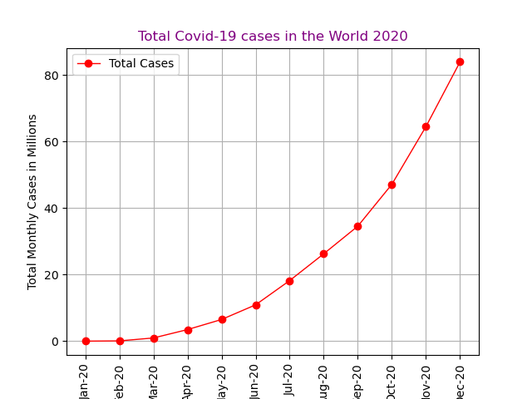
Notes:
Ash

Slide 13
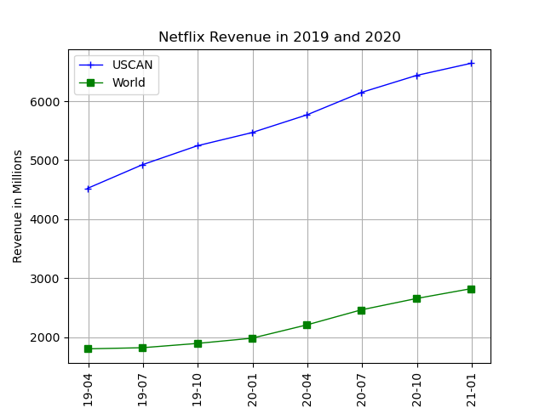
Notes:
Ash
(The total revenue made by USCAN alone equivalent to the GDP of a small country like Fiji)

Slide 14
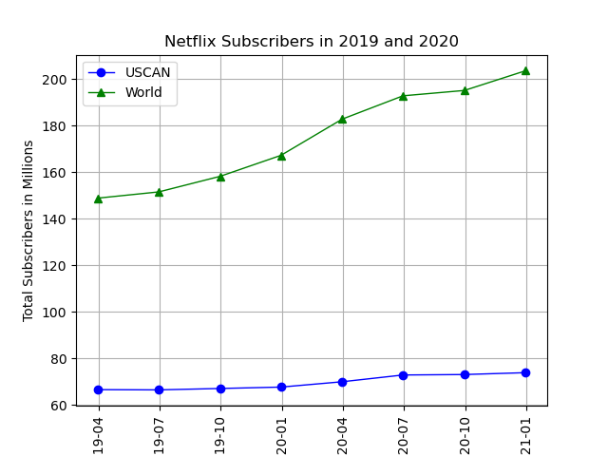
Notes:
Ash
( Total number of subscribers in USCAN is more than the population of Malaysia ! )

Slide 15
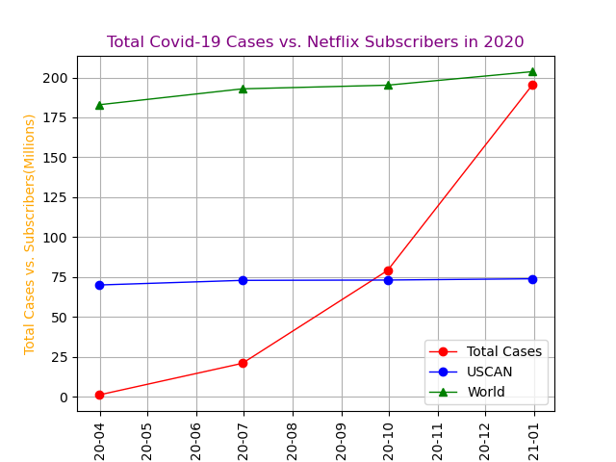
Total subscribers(2020):
USCAN:289.9 M
World: 774.7 M
Total Covid-19 Cases (2020) : 297 M
Notes:
Ash- COVID-19

Slide 16
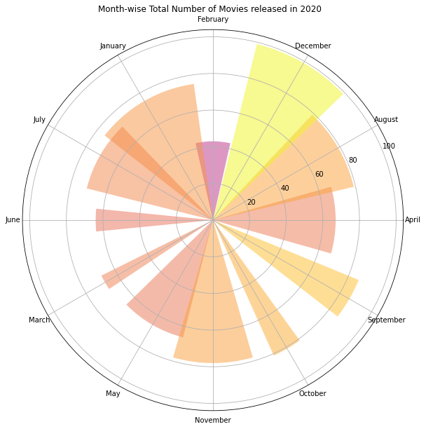
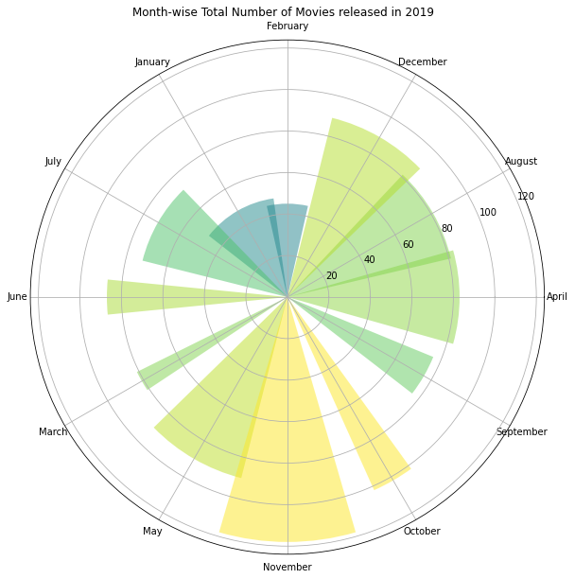

What were WE doing during 2020
What Netflix was doing during 2020
Notes:
Swati

Slide 17
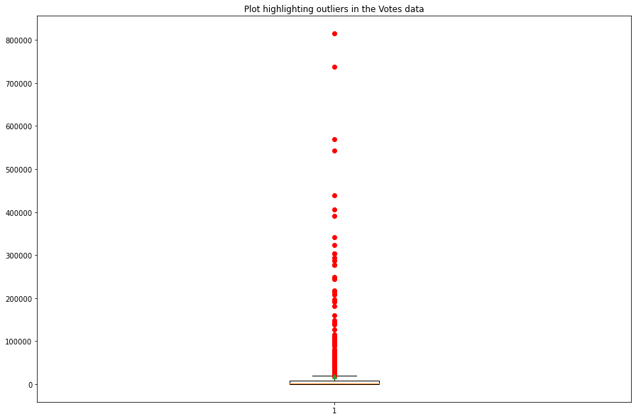
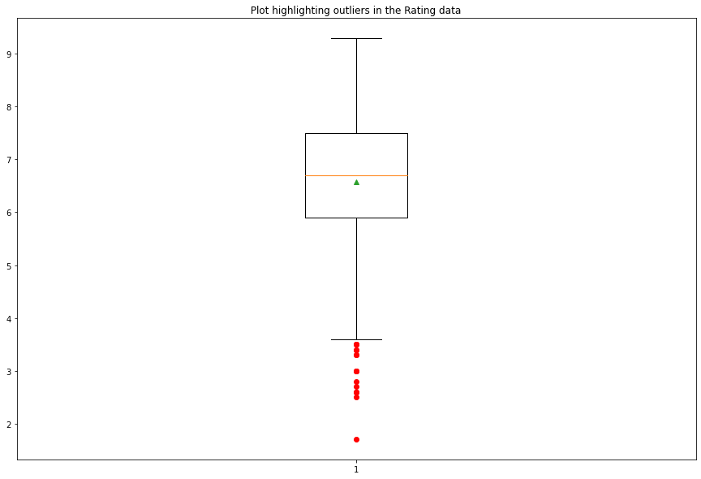
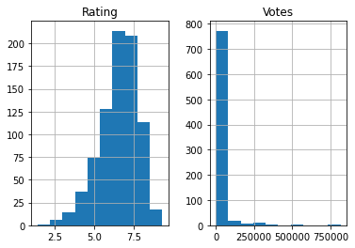
Notes:
Swati

Slide 18
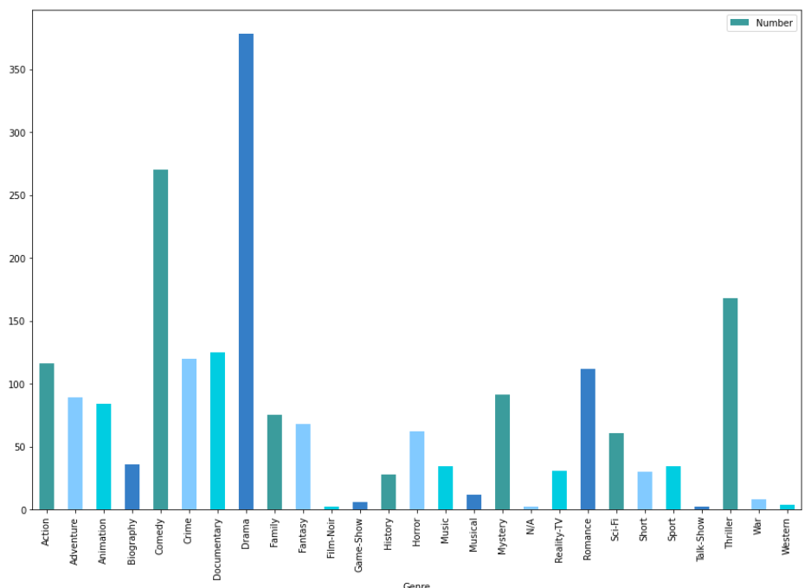
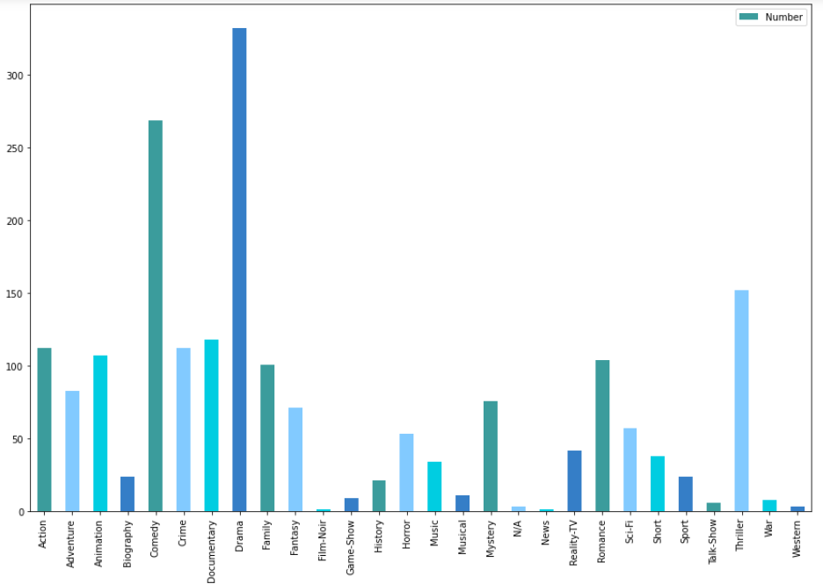
Top Genres by # Movies Released
2019: Drama, Comedy (972 = Total # Movies Released in 2019)
2020: Drama, Comedy (877= Total # Movies Released in 2020)
2019 Movies Released
2020 Movies Released
Notes:
Susan
We wanted to see if there were any trends in WHAT people were watching based on genres across 4 categories:
Movies released, votes, ratings, and revenue.
These charts look at the Top genres based on # of movies released.

Slide 19
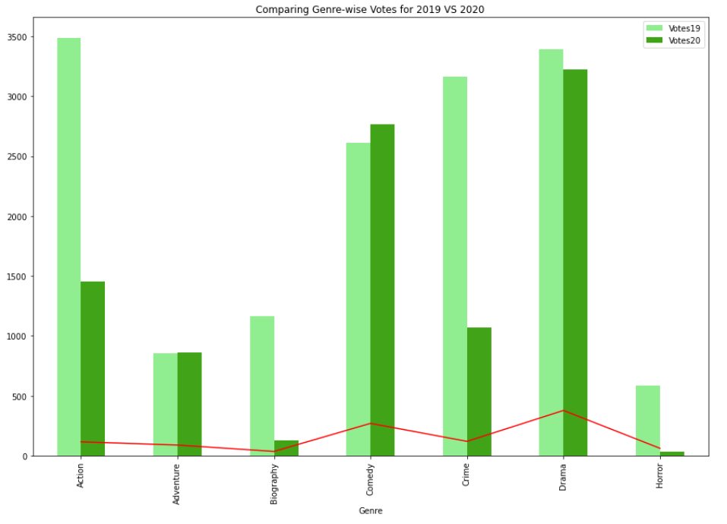
Top Genres by # Movies Released
2019: Drama, Comedy
2020: Drama, Comedy
Top Genres by Votes
2019: Action, Drama
2020: Drama, Comedy
Notes:
Susan
We used “Votes” as an indicator of viewing
Lines show # of movies
Looking at top genres by votes,
2019 = Action*, Drama
2020 = Drama*, Comedy
Or is this another indicator that this is what people were actually CHOOSING to watch vs. there was just more of these movie genres released?
*These were also the top revenue generating genres per year
Genre with Maximum Revenue 2019 ($ million) :- Action
Genre with Minimum Revenue 2019 ($million) :- Music
----------------------------------
Genre with Maximum Revenue 2020 ($ million) :- Drama
Genre with Minimum Revenue 2020 ($million) :- Horror

Slide 20
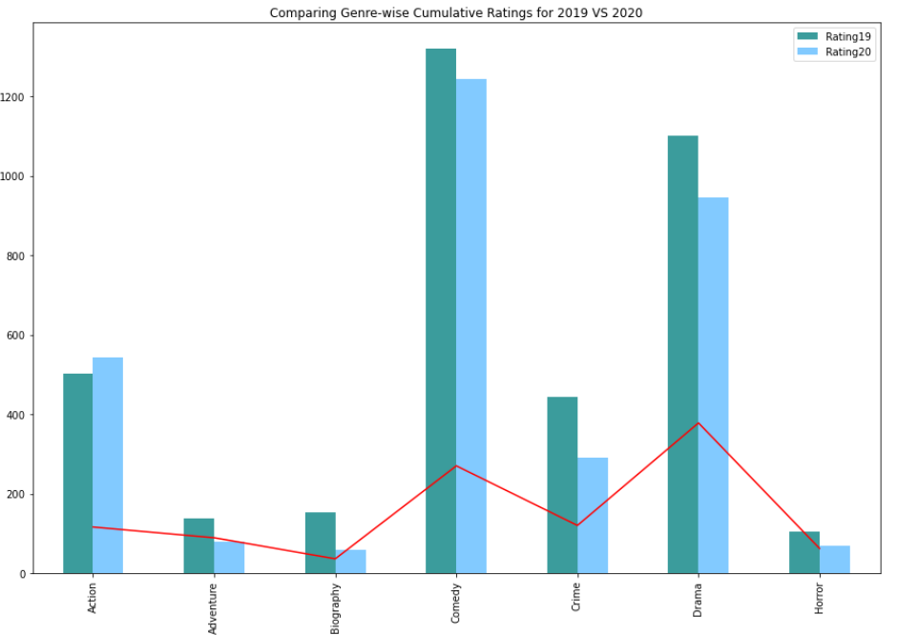
Top Genres by # Movies Released
2019: Drama, Comedy
2020: Drama, Comedy
Top Genres by Votes
2019: Action, Drama
2020: Drama, Comedy
Top Genres by Rating
2019: Comedy, Drama
2020: Comedy, Drama
Notes:
Susan
Lines show # of movies

Slide 21
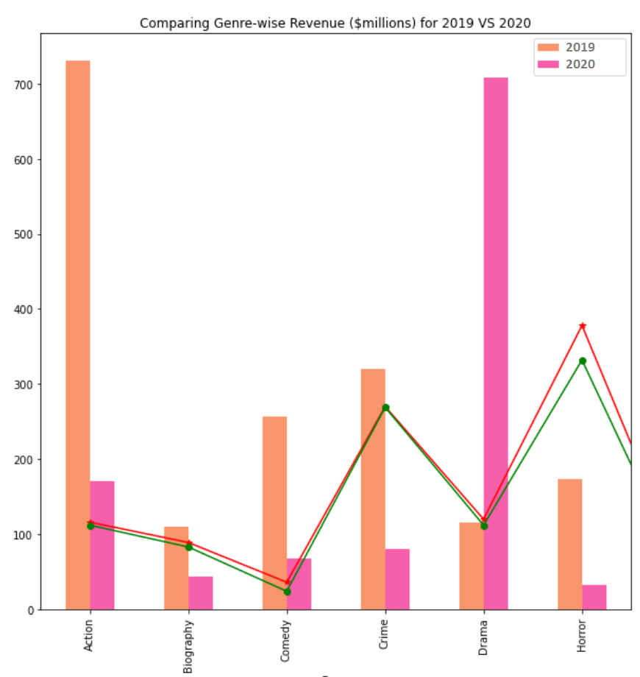
Top Genres by # Movies Released
2019: Drama, Comedy
2020: Drama, Comedy
Top Genres by Votes
2019: Action, Drama
2020: Drama, Comedy
Top Genres by Rating
2019: Comedy, Drama
2020: Comedy, Drama
Top Genres by Revenue
2019: Action, Crime
2020: Drama, Action
Notes:
Susan
Lines show # of movies

Slide 22
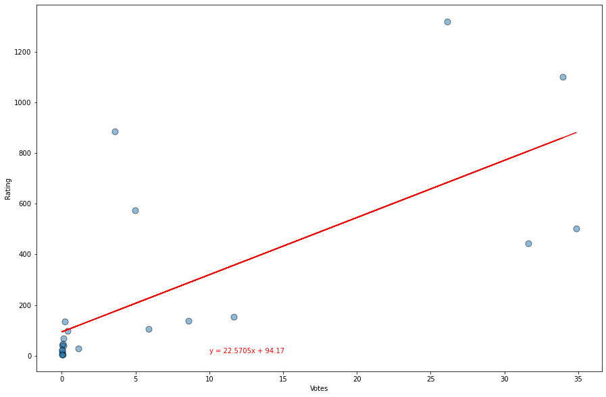
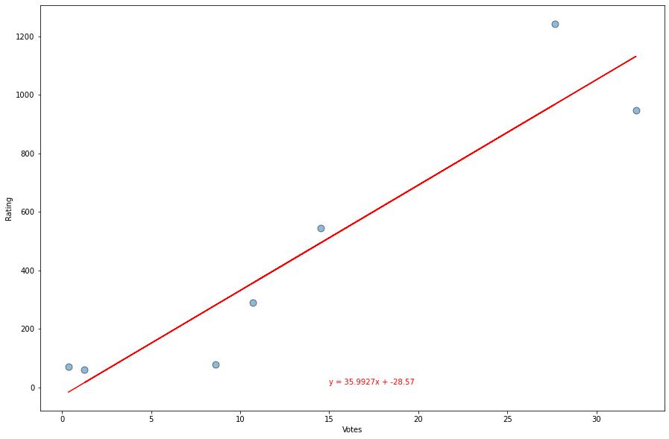
2020 Votes VS Ratings
2019 Votes VS Ratings
H_{a}: The number of ratings of a given genre has a strong positive relationship to the number of movie votes in that genre.

Slide 23
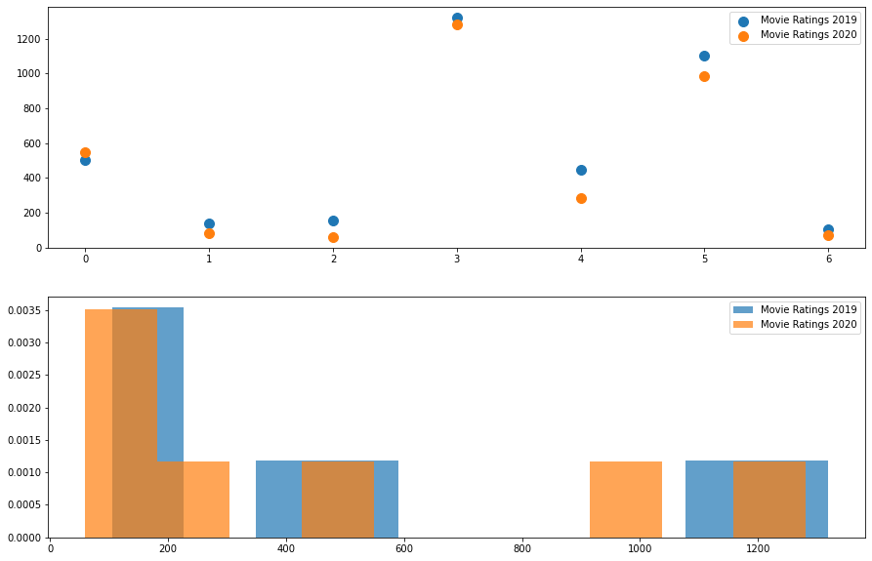
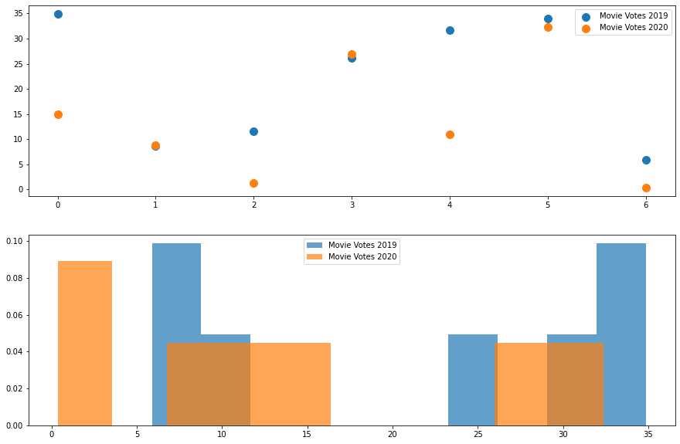
Statistical Analysis Results
T value = 0.2478, pvalue=0.80847)
T value = 1.2265, p-value=0.2435)
Notes:
Swati

Slide 24
It’s You - Not COVID-19
Most watched movie
2020- Tigertail
2019- Stranger Things
Lowest rated genres
2020- Biography
2019- Horror
Highest rated genres
2020- Comedy
2019- Comedy
Notes:
SARA- moving on here are some of the best movie titles based on the number of votes received
For genres we can note how biography was not a genre that a sample would gravitate towards and comedy ranks supreme

Slide 25
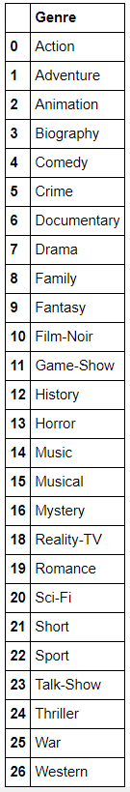
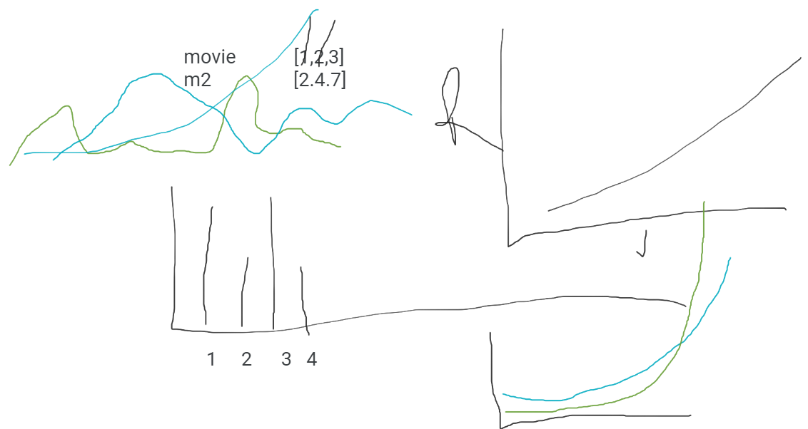
Fun “Facts”
579,122 movie records
27 genres
Netflix’s total revenue in 2020 $24,996,000,000
Worst movie titles*:
2020 “Cagaster of an Insect Cage”
2019 “Don't F**k with Cats…”
Kevin’s influence on Swati
*Absolutely no data to support this :-)
Notes:
Sara- now that we have gone over all the hard data let’s look at some of what we deem as the more important findings… our jupyter notebook pulled nearly 600k movie records with 27 genres
Netlix’s tot rev was 24B, which roughly equates to Iceland’s 2017 GDP
Your $10 a month collectively out spends iceland’s gvt
If you have some extra time on your hands you can check out the lowest rated movie titles
Preliminary drawings

Slide 26
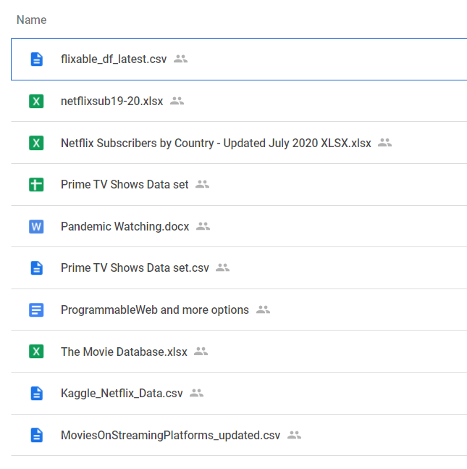
Difficulties and Future Study
Notes:
SARA- to wrap it up, some difficulties that arose were the initial finding of the data as you can see from this screenshot of our google drive. We ended reviewing over 20 different data sources from csvs to apis to various websites. During our initial research we discovered that netflix and other streaming services decide to make their api’s private. Why you might ask? Bc the companies don’t stand to gain anything if they make their api public. For example, if i was going to launch my own streaming service, and i could use the netflix api i would be able to see what shows were viewed the most and i would use that info to put those shows on my streaming service. So once we discovered that we couldn’t use a company’s proprietary api that got us on the topic of 3rd party apis- how often they are updated and are they credible more importantly. The finding the 2019 and 2020 data was much more difficult to find than all the archived years.
If we had more time our research would look into a specific international case study to see if our hypothesis could be applied outside the US. We would also like to research other streaming services such as Hulu, Amazon Prime, etc.
Finally, in this project, we limited ourselves to movies as to not overwhelm ourselves with data on tv shows. We discussed if we wanted to analyze tv shows we would have needed to account for various seasons and that would have been a lot to look at coupled with movies

Slide 27
Applause
Notes:
SARA- thank you for your time, any questions? open-floor Q&A

